Slide 1
Personalization and Privacy
Ben Livshits
Researcher
Microsoft Research

Slide 2
Big Data? Why Share?
Currently
Our vision
User data aggregated in cloud
This data is toxic
Compliance with privacy policies
Compliance with laws, local and international
Powering the data center
The only upside is learning more about user
Keep user data local to user
Do user profiling on device
Do it better and cheaper
Share very little and only when needed

Slide 3
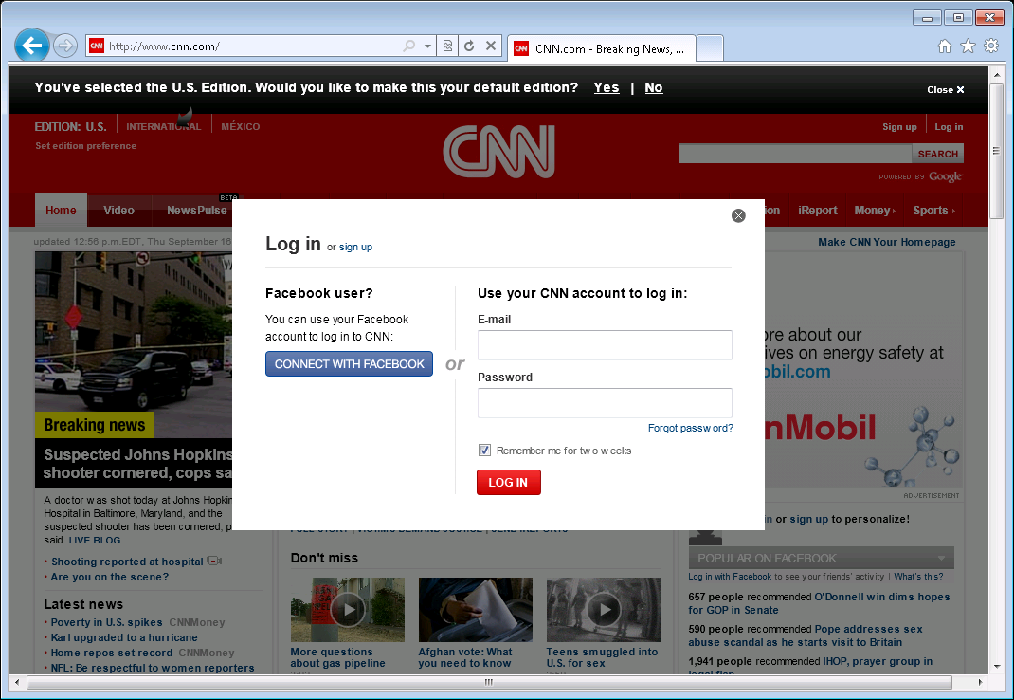
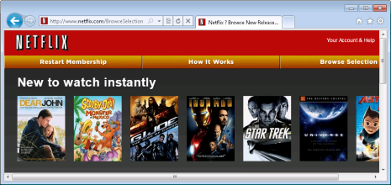
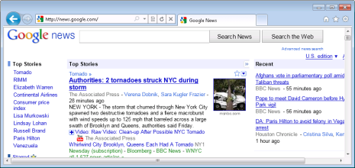
Privacy concerns
Share data to get personalized results
New York Times
Netflix
Google news
Amazon

Slide 4
Browser: Personalization & Privacy
Broad applications:
Site personalization
Personalized search
Ads
User data in browser
Control information release
Your browser
Google
Netflix
Amazon
12
12
12
12
1
11
1
1
11
1
11
Browsing history
11
10
2
10
2
10
10
2
Top: Computers: Security: Internet: Privacy
Top: Arts: Movies: Genres: Film Noir
Top: Sports: Hockey: Ice Hockey
Top: Science: Math: Number Theory
Top: Recreation: Outdoors: Fishing
2
9
3
9
3
9
9
3
3
8
4
8
4
8
8
4
4
7
5
7
5
7
7
5
5
6
Distill
6
6
6
User interest profile

Slide 5
Scenario #1: Online Shopping
bn.com would like to learn your top interests. We will let them know you are interested in:
Science
Technology
Outdoors
Interest profile
Interest profile
Accept
Decline
Notes:
Here is a more detailed look on how we expect this story to play out.
Suppose we would like to visit a new online merchant, and still receive a personalized experience…
We have used amazon.com loyally for years, and built up a fairly detailed interest profile. This is useless on a new merchant, such as bn.com
Run through RePriv-enabled scenario of user visiting a new online merchant, and receiving a personalized experience.
Illustrates use of general interest mining.
Trust BN.com with not leaking the profile further

Slide 6
RePriv Protocol
GET /index.html HTTP 1.1
Host: www.example.com
Accept: repriv …
HTTP/1.1 300 Multiple Choices
index.html
index.html?top-n&level=m
POST /index.html HTTP 1.1
Host: www.example.com
Content-Length: x
category1=c1&…
HTTP/1.1 200 OK
Personalized page content
Notes:
Core mining is communicated to content providers with a simple protocol.
Walk through instance of protocol.
Backwards-compatible with existing HTTP implementations
Enables personalization to occur on the server-side.
Communicates topic-specific information, as well as global interest profile statistics

Slide 7
Privacy-Aware News Personalization
Map RePriv interest taxonomy to del.icio.us topics
Query personal store for top interests
Ask del.icio.us API for “hot” stories in appropriate topic areas from nytimes.com
Replace nytimes.com front page with del.icio.us stories
Notes:
Our algorithm is an approximation of a collaborative recommendation system
It relies on del.icio.us

Slide 8
Privacy Policy
Query del.icio.us with top interest data
Change “href” attribute of anchor elements on nytimes.com
Change TextContent of selected anchor and div elements on nytimes.com

Slide 9
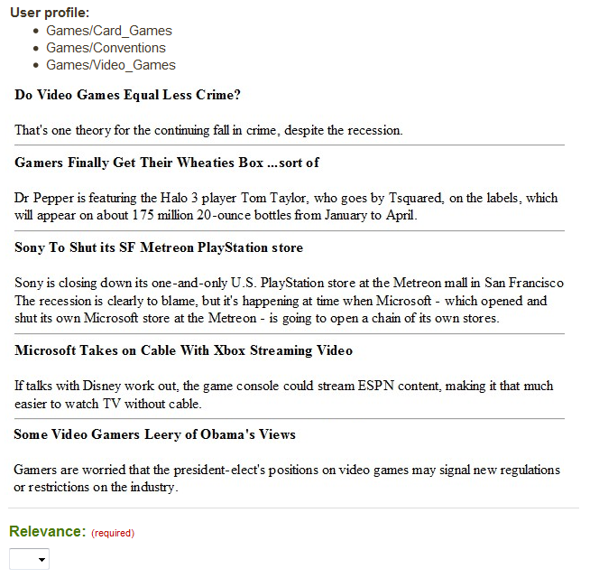
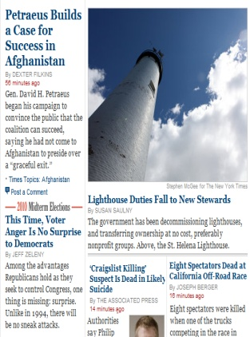
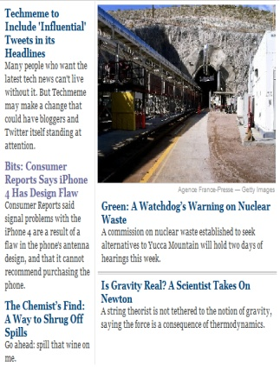
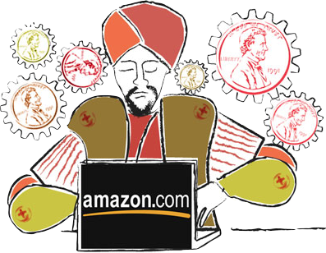
Evaluation Process
Technology/Web 2.0
Technology/Mobile
Science/Chemistry
Science/Physics
2,200 questions
Over 3 days
Types of results
Default
Personalized
Random
Notes:
Ask the audience: which new york times front page is more likely to interest the author of these slides?
The front page on the right was generated by our personalization extension.
Personalized content, such as that on the right, is becoming more popular on the web.

Slide 10
News Personalization: Effectiveness
Personalized
Most responses rated highly!
Random
Most responses rated poorly
Default
User Relevance Score
Notes:
Show results from Mturk study – violin plot.

Slide 11
RePriv Summary
Existing solutions require privacy sacrifice
RePriv is a browser-based solution
User retains control of personal information
High-quality information mined from browser use
General-purpose mining useful & performant
Flexibility with rigorous guarantees of privacy
Personalized content & privacy can coexist
Notes:
RePriv embodies the notion that privacy is the right of the individual to control their personal information
RePriv includes default, general-purpose behavior mining that does not affect browser performance
RePriv allows third-party code for flexibility, but uses rigorous software analysis to protect user privacy
Takeaway point: today’s personalized applications do not require the user to sacrifice privacy excessively
We built RePriv to be flexible enough to accommodate next-gen personalized apps

Slide 12
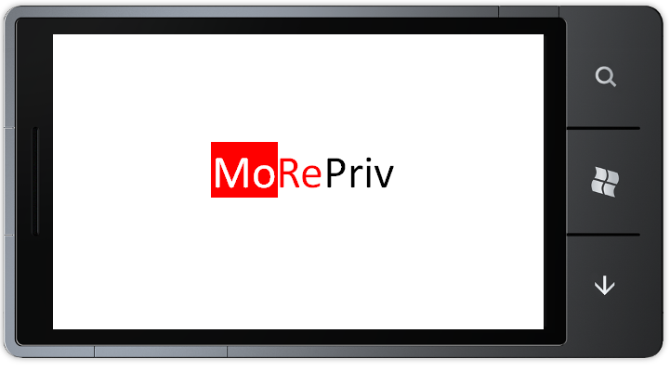
Aggressive, privacy-conscious personalization for
Windows Phone

Slide 13
Powerful Insight About User on Mobile

Slide 14
Analogy: Location Access
Location/GPS access has changed mobile apps as we know them today
Location APIs are widely used by 3rd-party apps
Want to do the same for persona data

Slide 15
Profiling the User on the Device
MoRePriv was built into WP 7.5:
Persona mining
Universal personalization
Persona APIs for apps
Political junkie
Soccer Mom
Bachelor
Tween
Professional
Retiree
Football Dad
Technophile

Slide 16
Personae in Use

Slide 17
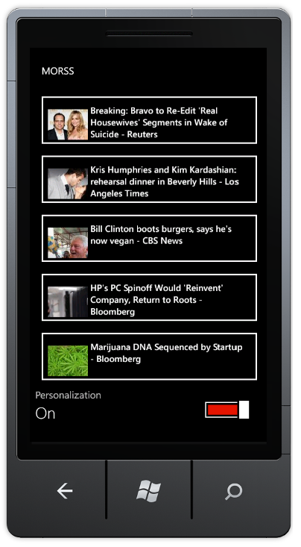
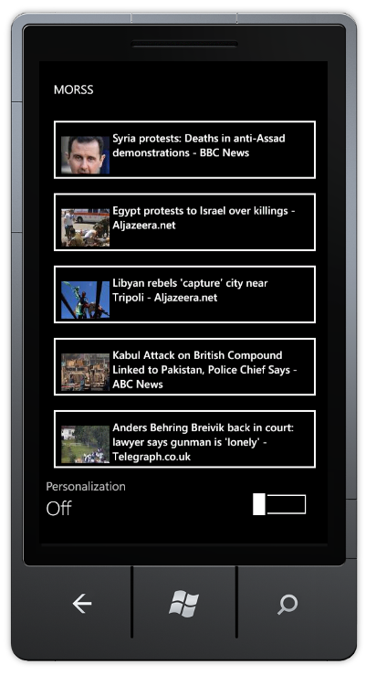
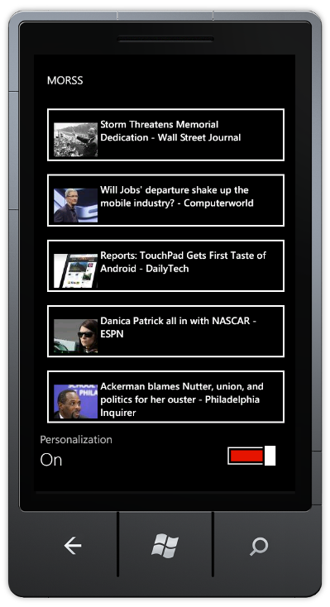
Mobile Personalization: Example
Soccer Mom
No Personalization
Technophile

Slide 18
Personalizing Yelp Listings
Executive
Student

Slide 19
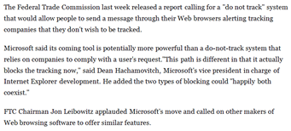
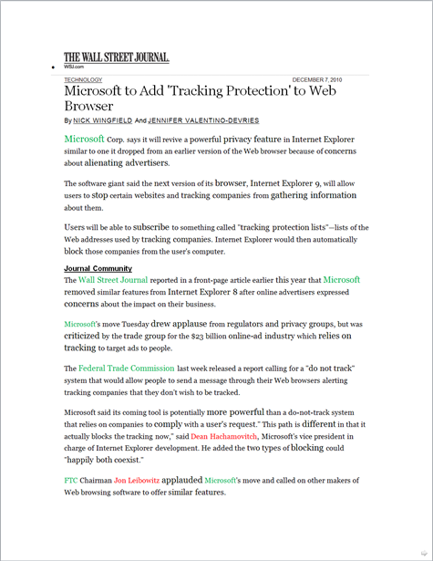
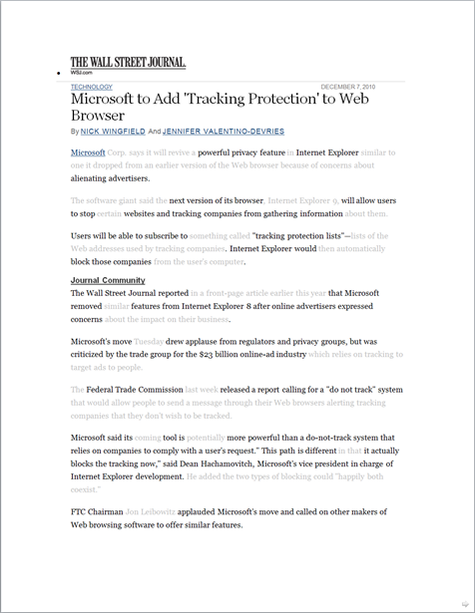
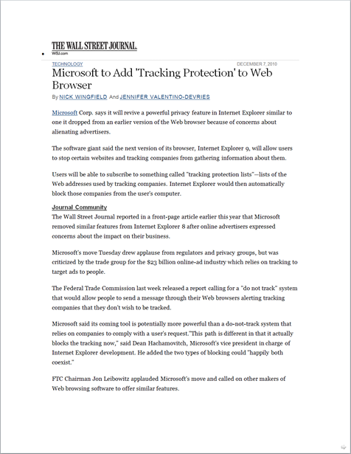
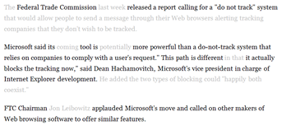
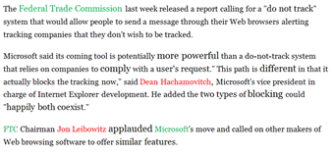
Text Summarization
Generic excerpt
For a “technophile”
For a “business professional”

Slide 20
MoRePriv Summary
Profile users on the device itself
MoRePriv uses personas to represent user
Allow for personalization
Can be as ubiquitous as location info is now
Leaking personas is not such as big deal
Personalized content & privacy can coexist
Notes:
RePriv embodies the notion that privacy is the right of the individual to control their personal information
RePriv includes default, general-purpose behavior mining that does not affect browser performance
RePriv allows third-party code for flexibility, but uses rigorous software analysis to protect user privacy
Takeaway point: today’s personalized applications do not require the user to sacrifice privacy excessively
We built RePriv to be flexible enough to accommodate next-gen personalized apps

